Slide 1
Exit Interview
By: Jose Mendez

Slide 2
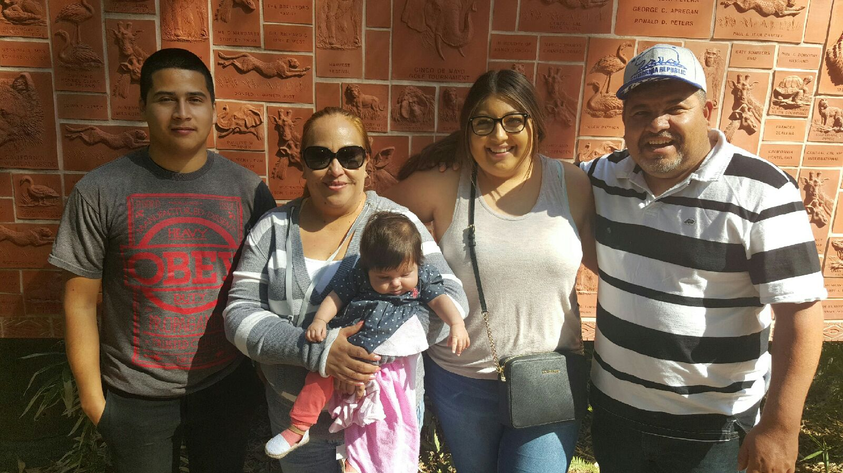
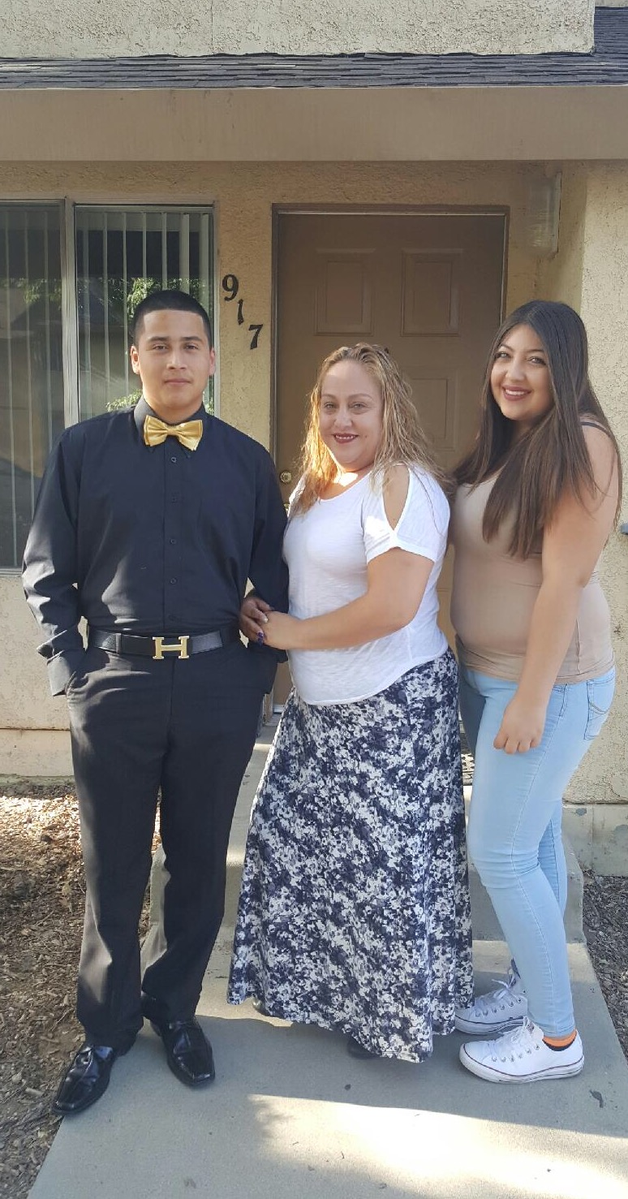
About Me
I am 18 years old
I was born in Lindsay California
I was raised from a very hardworking mother who works hard every day to give my sisters and I a better life.
I have two sisters the oldest is 20 and the youngest is three months I am the middle child
Characteristics: respectful, hardworking and outgoing

Slide 3

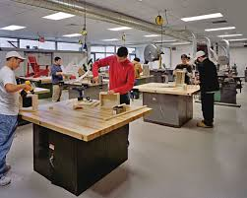
High School Experience
Football
Wood shop
Art
Met new people and made friends

Slide 4
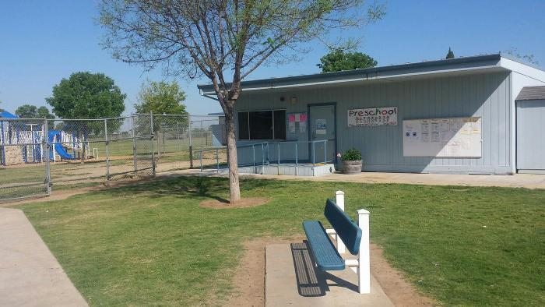
Job Shadow
Job shadow took place at Jefferson Elementary
I Job shadowed Miss. Lizz Preschool class
Working with kids
Hands on activities

Slide 5


Pathway
Spanish
Spanish 3
Spanish is important because it can help you find good jobs.

Slide 6
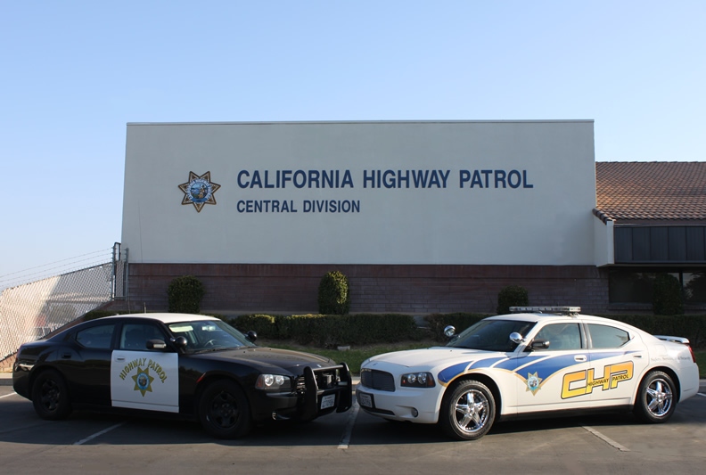

Plans after High school
Attend to PC
Only 2 years
Go to police Academy
Law Enforcement

Slide 7


